Slide 1
Sentiment Analysis
Earth Day 2022 Tweets

Slide 2
Background & Objective
Background:
Earth Day is an annual event on April 22 to demonstrate support for environmental protection.
First held on April 22, 1970, the official theme for 2022 was Invest In Our Planet
Objective:
Scrape #Earthday tweets
Perform sentiment analysis
Present findings

Slide 3
Data
S3
Scraped Tweets
Twitter
Tweets
S3
Predictions Output
QuickSight
Dashboard
Kinesis
Streaming Tweets
Databricks
Sentiment ML
Athena
SQL Query
EMR
Clusters

Slide 4
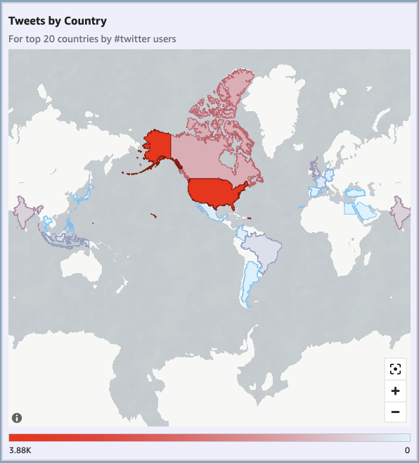
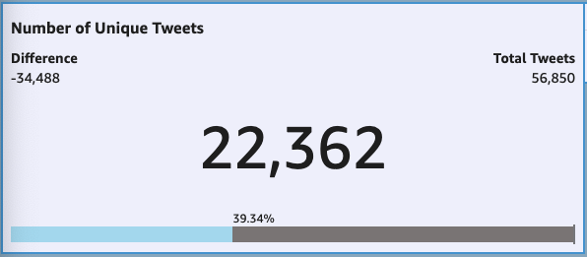
Tweet Analysis: Count and Distribution
39% Unique Tweets
61% Retweets

Slide 5
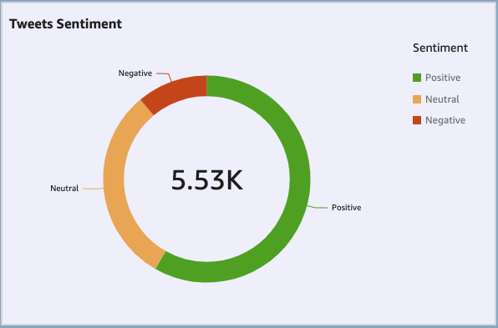
Tweet Analysis: Sentiment
58% Positive Sentiment
31% Neutral Sentiment
11% Negative Sentiment

Slide 6
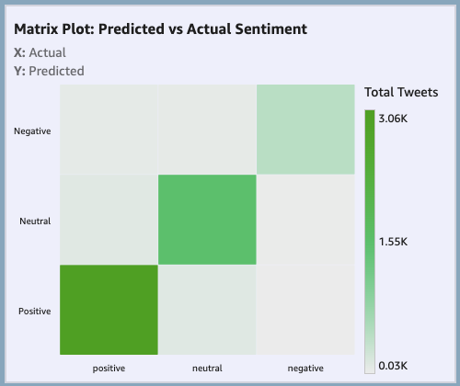
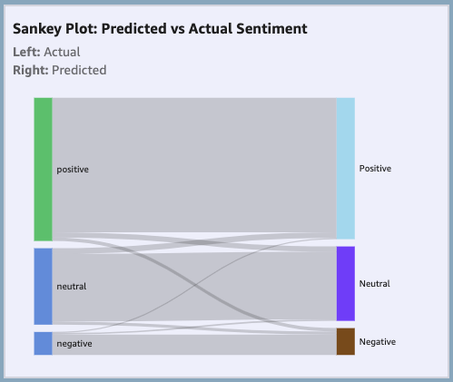
Tweet Analysis: Prediction Evaluation
Accuracy | Precision | Recall | F1
0.92 | 0.95 | 0.94 | 0.92

Slide 7
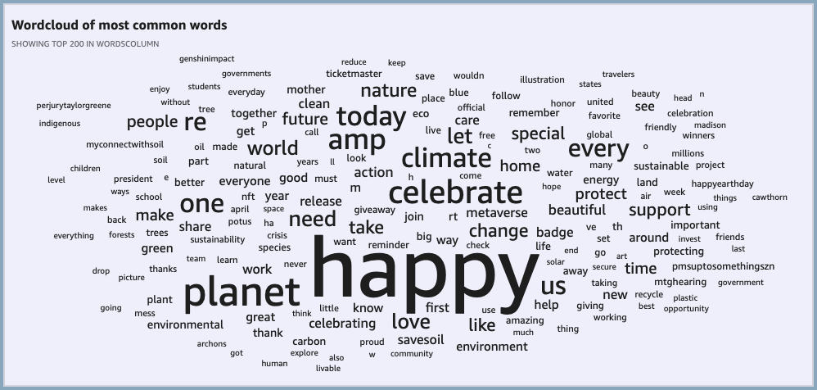
Tweet Analysis: Word cloud

Slide 8
Challenges & Conclusion
Challenges:
Limited EC2 instances with community DataBricks version was a bottleneck
Scraping for additional tweets later since the trend was date related
61% of tweets were retweets
Conclusion:
Sentiments mostly positive
Logistic Regression better compared to Tree based models
Overall good sentiment prediction with F1 score of 92%

